Slide 1



Session-07 Single-cell immune repertoire analysis
Amit Upadhyay
Research Assistant Professor
Bosinger Lab

Slide 2
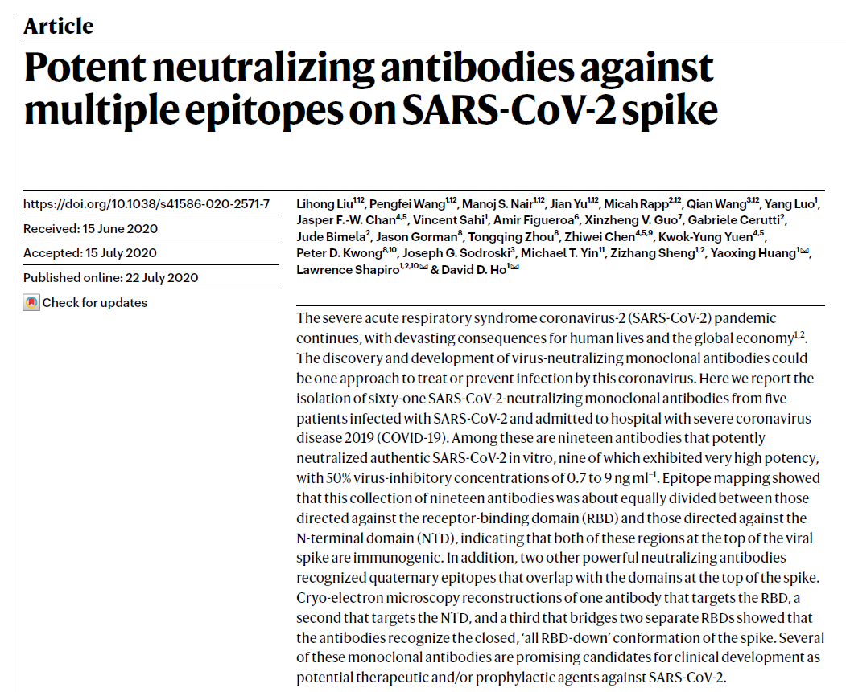
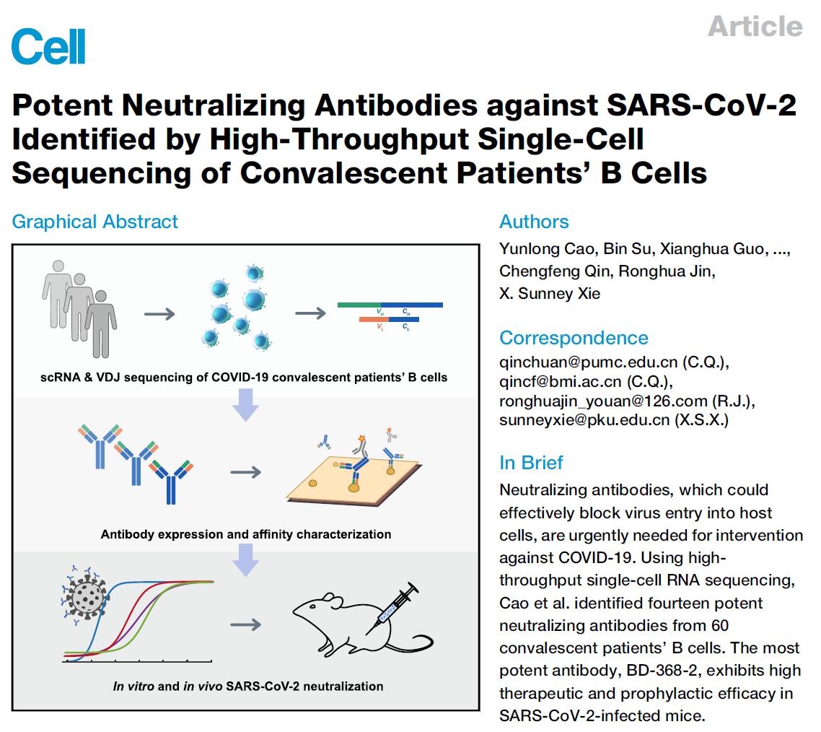
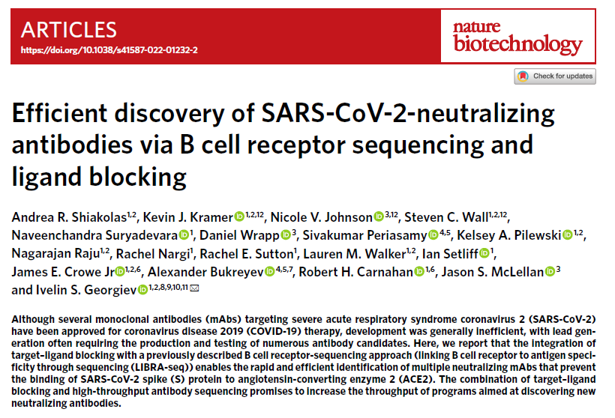
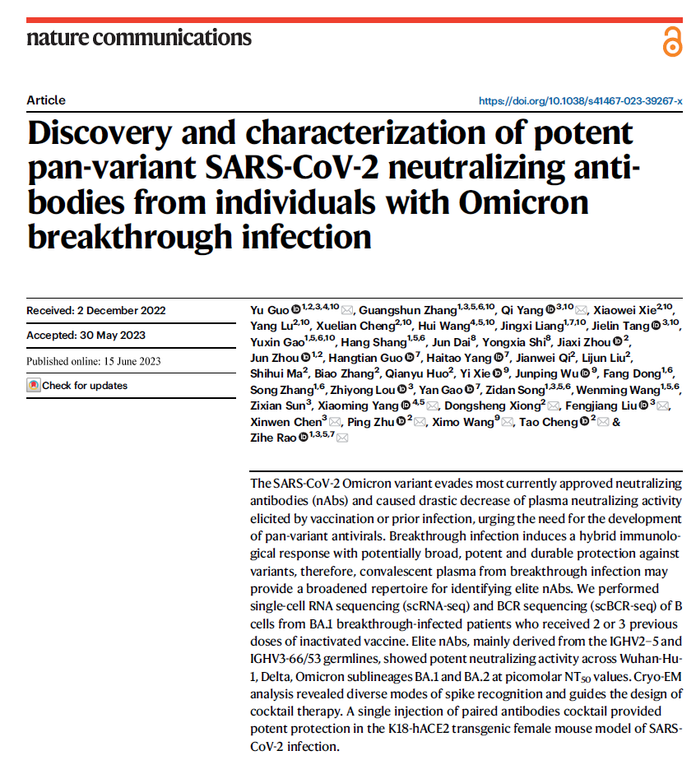
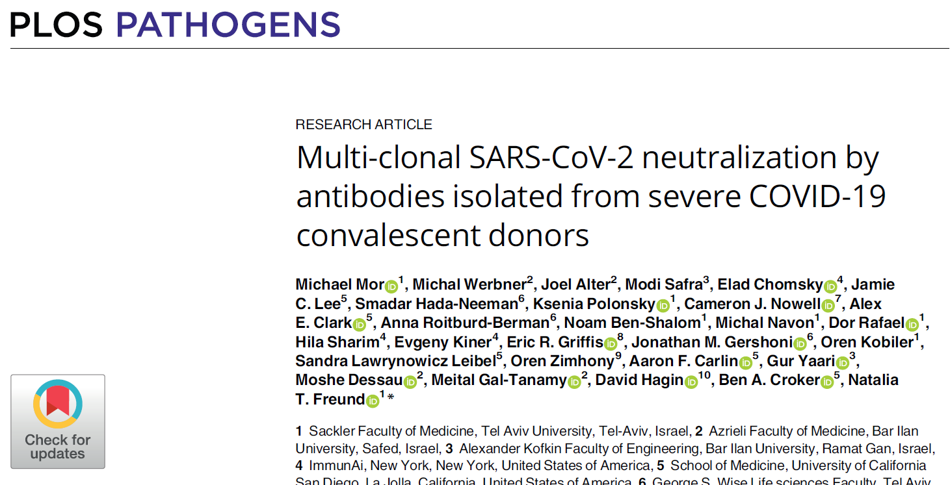
Applications – Neutralizing antibody discovery

Slide 3
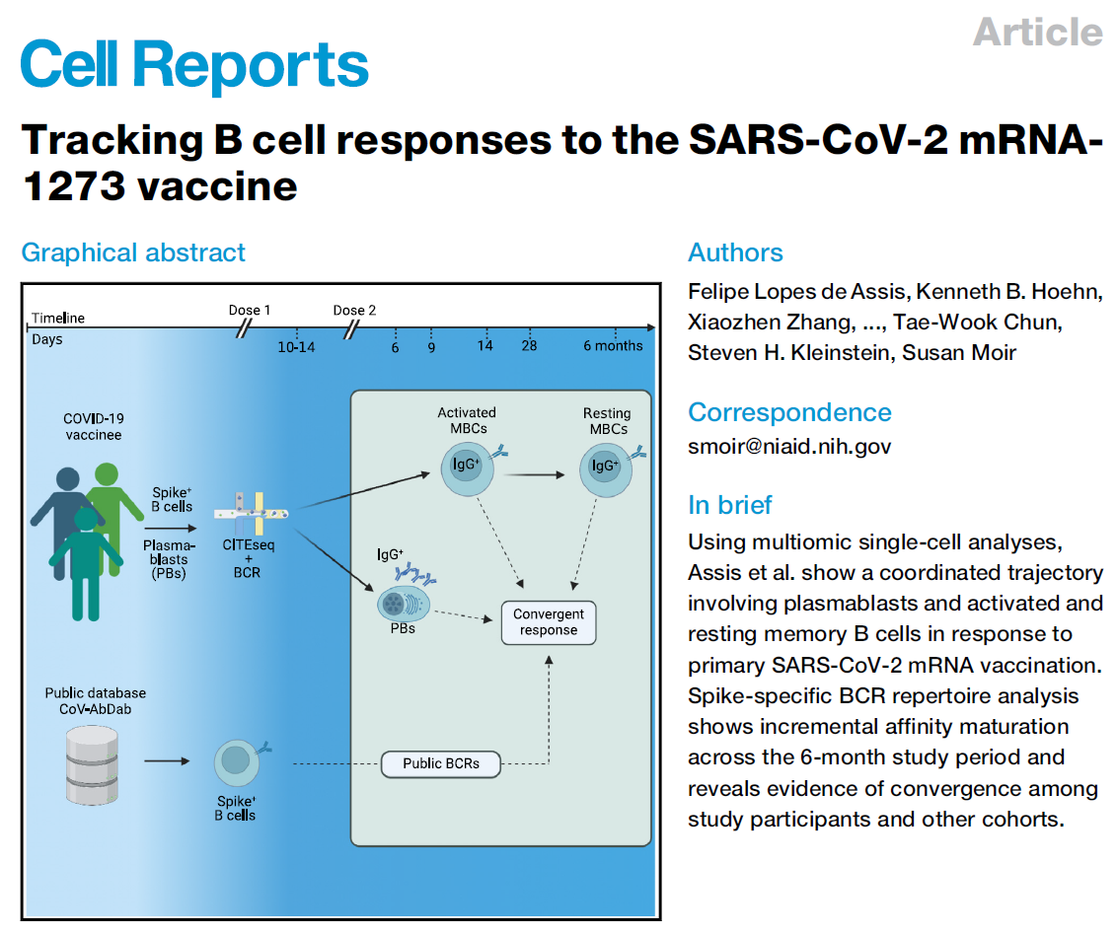
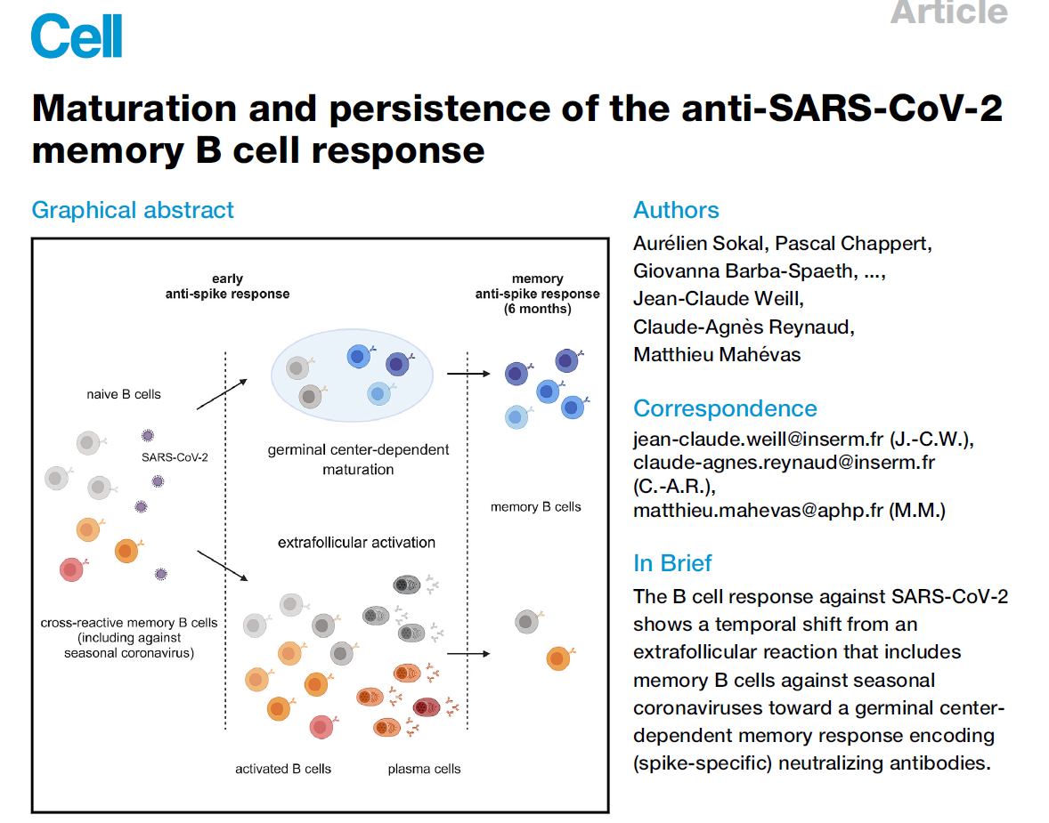
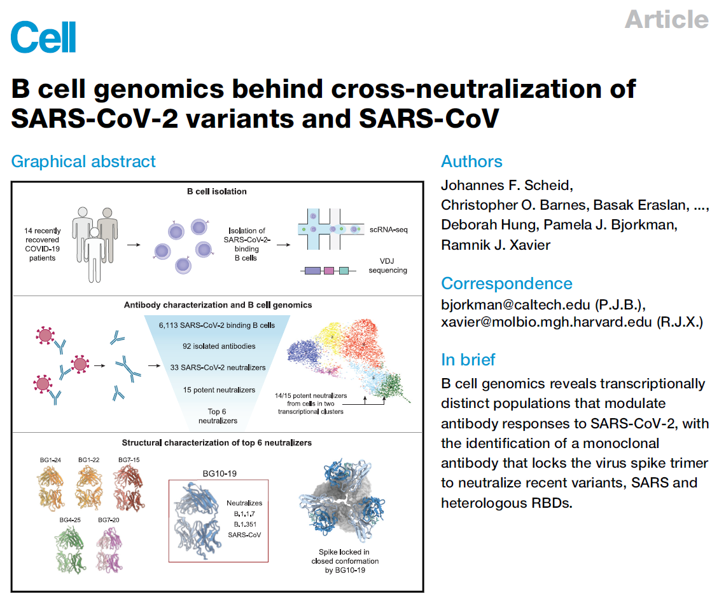
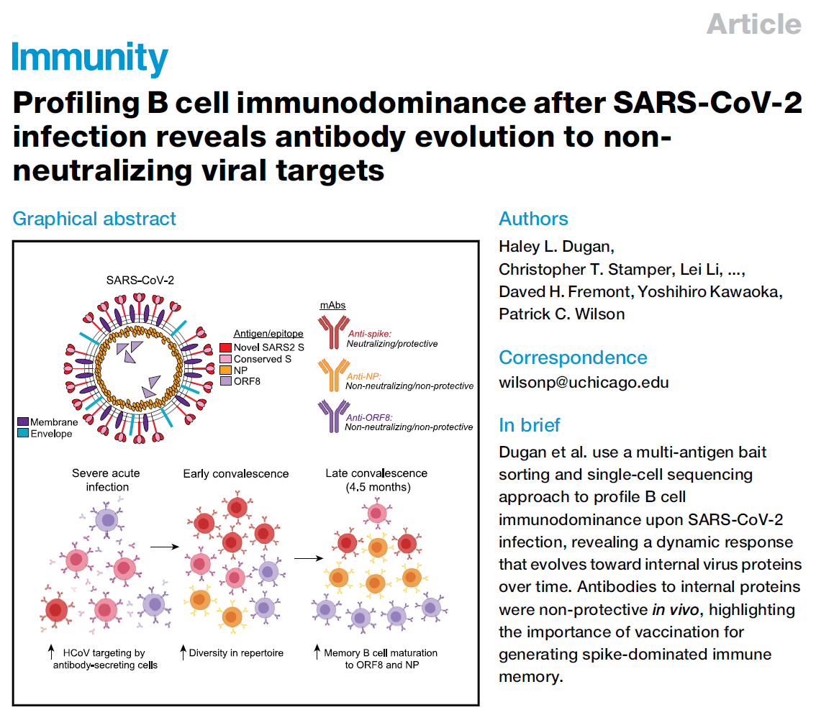
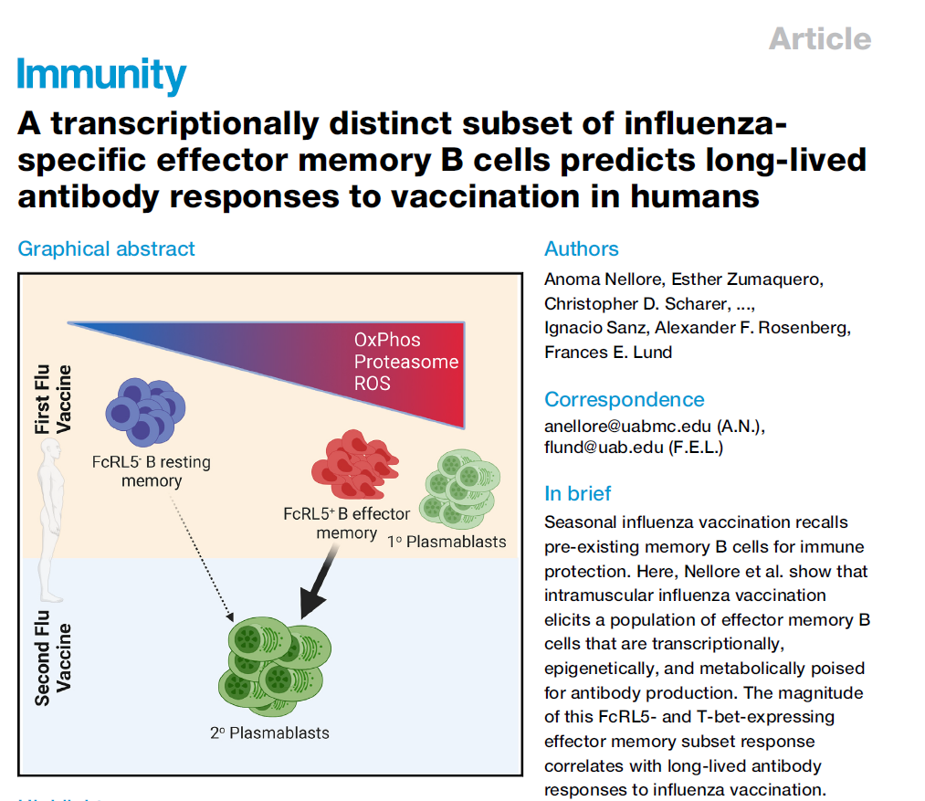
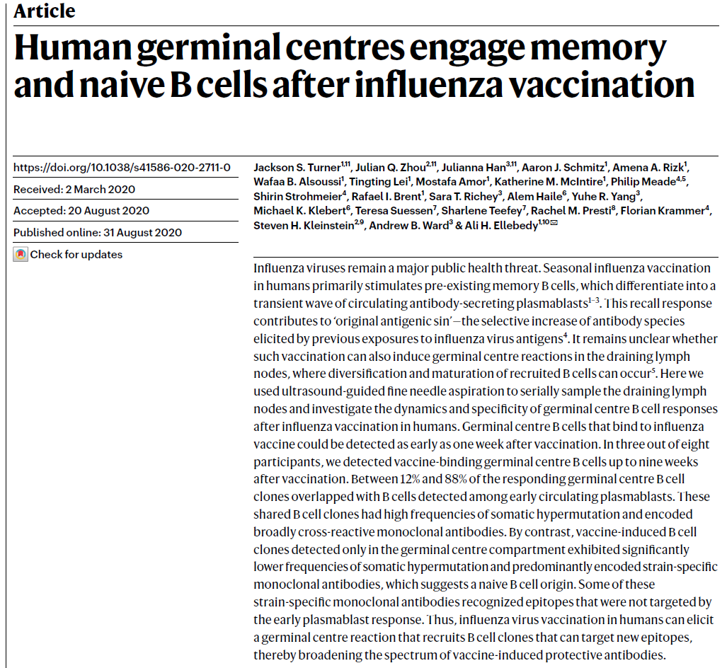
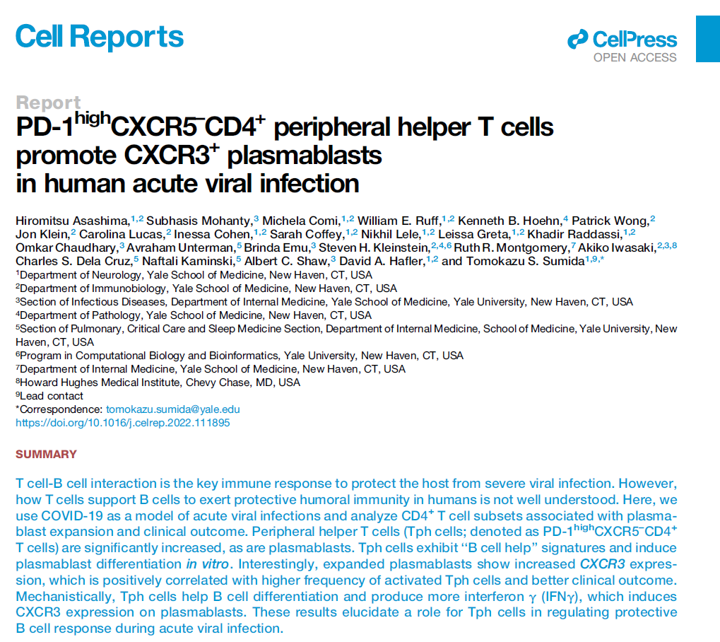
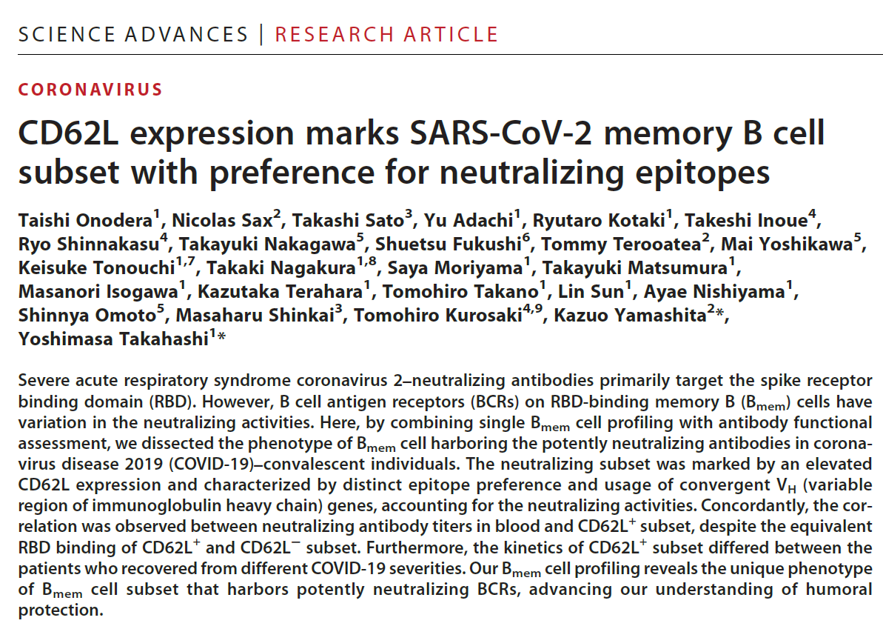
Applications – Lineage tracing

Slide 4
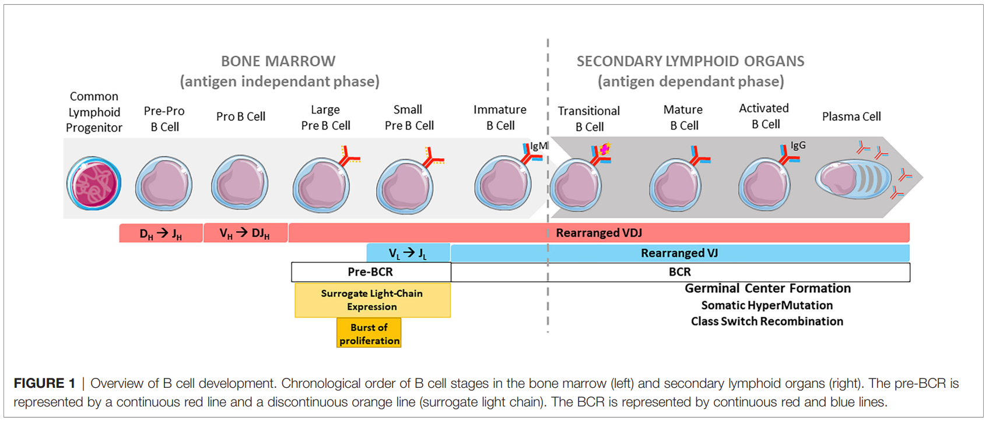
B cell development
Front Immunol . 2022 Jun 24:13:877930

Slide 5
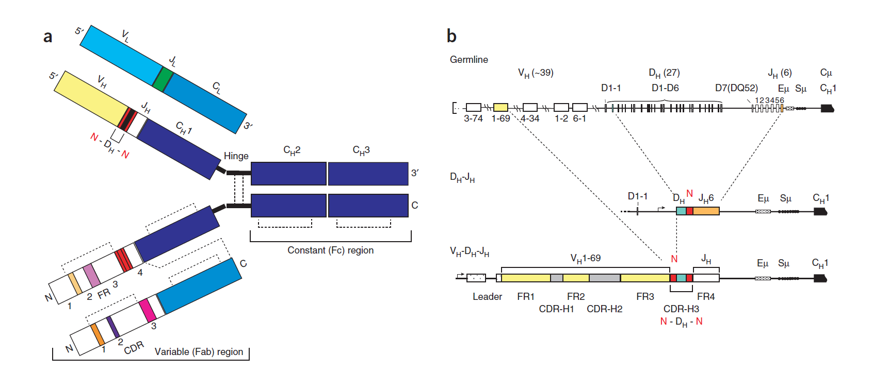
Mature BCR made up of rearranged V(D)J gene segments
. 2014 Feb;32(2):158-68
Nat Biotechnol. 2014 Feb;32(2):158-68.
Notes:
Every B cell is different and highly diverse

Slide 6
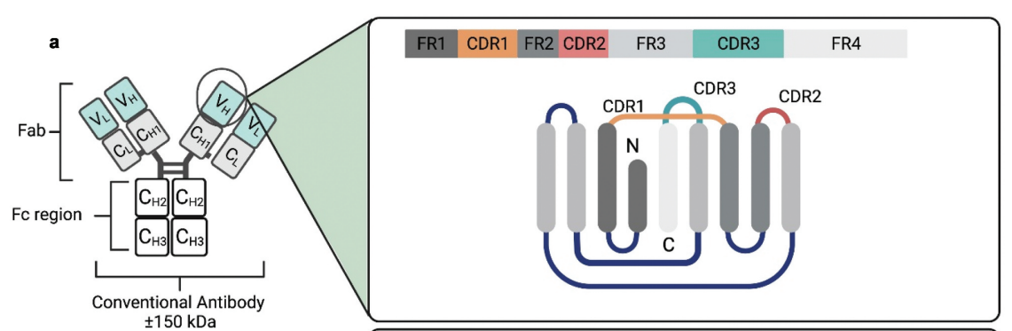
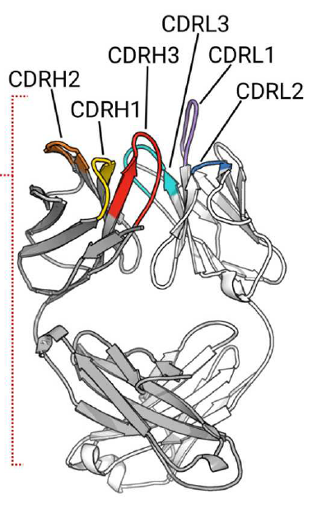
Framework and CDR regions
https://doi.org/10.1080/13543784.2023.2249814
FR1-IMGT: 1 to 26 (26)
FR2-IMGT: 39 to 55 (17)
FR3-IMGT: 66 to 104 (39)
FR4-IMGT: 118 to 129 (11)
CDR1-IMGT: 27 to 38 (12)
CDR2-IMGT: 56 to 65 (10)
CDR3-IMGT: 105 to 117 (13)
Front Immunol . 2019 Oct 15:10:2454
Dev Comp Immunol . 2003 Jan;27(1):55-77

Slide 7
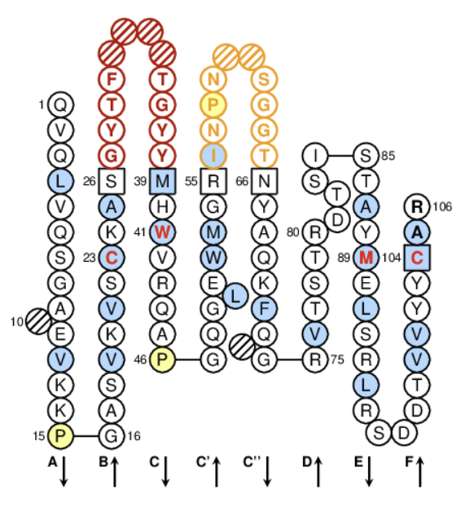
IMGT Numbering
Easily compare the variable regions (V-REGION) of IG and TR from all species
Provides positions of the amino acids (and corresponding codons) in coding sequences, in 2D graphical representations, and in 3D structures
Relies on the high conservation of the structure of the variable region
Set up after aligning more than 5000 sequences, takes into account and combines
the definition of the framework (FR) and complementarity determining regions (CDR),
Structural data from X-ray diffraction studies, and
The characterization of the hypervariable loops.
Delimitations of the FR- and CDR-IMGT regions based on the longest ones found in the IMGT/LIGM-DB multiple alignments
IGHV1-2*01 (X07448)
Dev Comp Immunol . 2003 Jan;27(1):55-77
https://www.imgt.org/IMGTrepertoire/2D-3Dstruct/Colliers_dyn.php

Slide 8
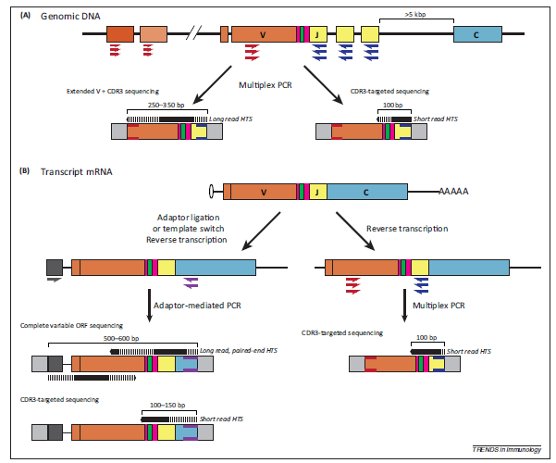
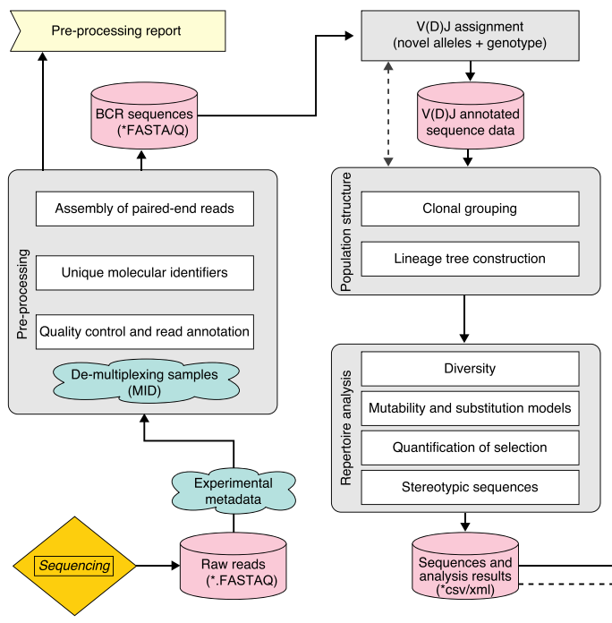
Bulk repertoire sequencing
Trends Immunol . 2014 Dec;35(12):581-590
Genome Med . 2015 Nov 20:7:121

Slide 9
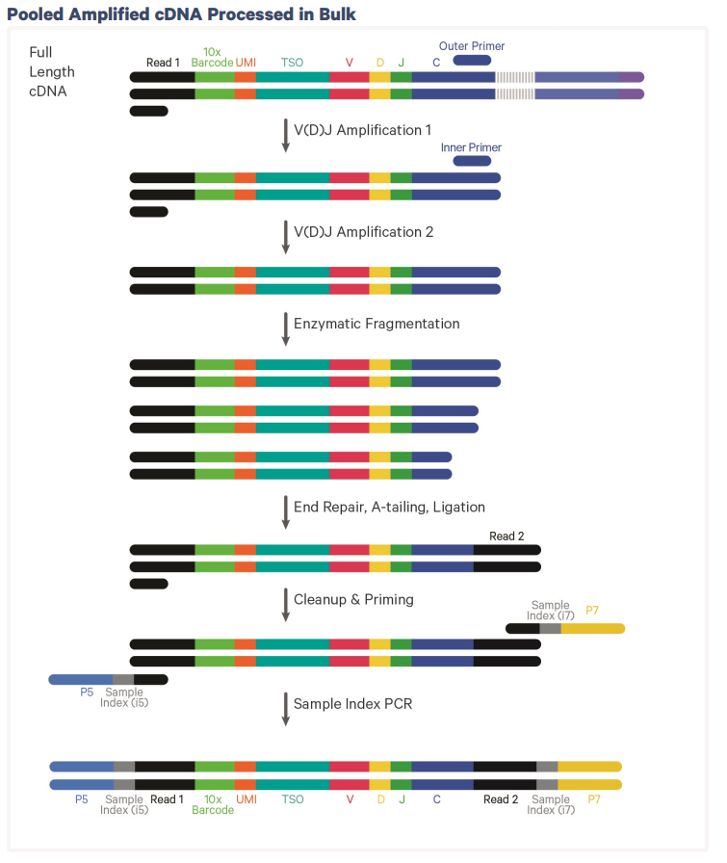
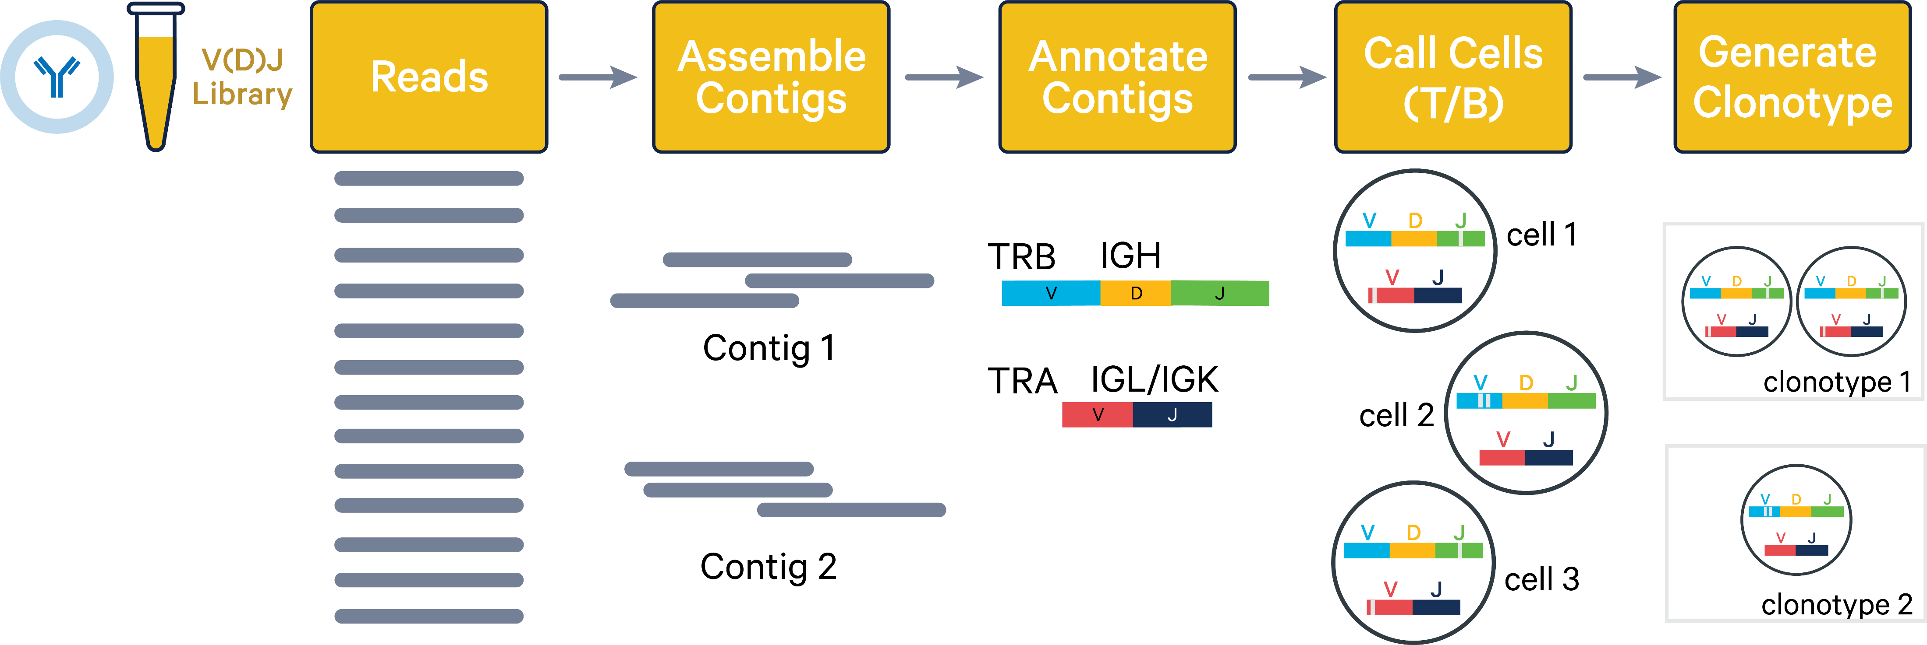
10X Single cell Immune Profiling
https://www.10xgenomics.com/

Slide 10
Assembly Algorithm
Cellranger VDJ - Pipeline
Annotation Algorithm
Clonotype Grouping
Adapter trimming
Read subsampling
Read trimming
Graph formation
Ref-free graph simplification
Ref-assisted graph simplification
UMI filtering
Contig construction
Competitive deletion of contigs
Contig confidence
Contig quality scores
Alignment to the V(D)J reference
Productive Contigs
Full length requirement
Start requirement
Nonstop requirement
In-frame requirement
CDR3 requirement
Structure requirement
CDR3
Clonotype grouping by enclone
Germline sequences
Exact subclonotype grouping
Joining subclonotypes into clonotypes
Clonotype and barcode filtering by enclone

Slide 11
10X Pre-built human references
Human VDJ reference:
wget https://cf.10xgenomics.com/supp/cell-vdj/refdata-cellranger-vdj-GRCh38-alts-ensembl-7.1.0.tar.gz
Human GEX reference:
wget https://cf.10xgenomics.com/supp/cell-exp/refdata-gex-GRCh38-2020-A.tar.gz

Slide 12
Reference database for cellranger VDJ
IMGT
$ source path/to/cellranger-7.1.0/sourceme.bash
$ path/to/cellranger-7.1.0/lib/bin/fetch-imgt --genome vdj_IMGT_human --species “Homo sapiens“
$path/to/cellranger-7.1.0/cellranger mkvdjref --genome=vdj_IMGT_human --seqs=vdj_IMGT_human-mkvdjref-input.fasta
Genome based (Ensembl) – genome FASTA file and gene GTF annotations
$ cellranger mkvdjref --genome=my_vdj_ref \
--fasta=GRCh38_ensembl.fasta \
--genes=GRCh38_ensembl.gtf

Slide 13
Dataset
Integrated GEX, TotalSeq™-C, and BCR Analysis of Chromium Connect Generated Library from 10k Human PBMCs
PBMCs isolated from a healthy donor
Gene Expression, BCR, and Antibody Capture libraries
10,000 cells targeted
11,075 cells detected
68,396 mean reads per cell
Sequenced on Illumina NovaSeq with 28 bp read 1, 90 bp read 2, 10 bp i5 sample barcode, and 10 bp i7 sample barcode

Slide 14
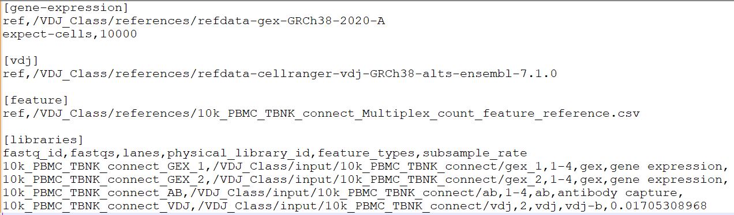
cellranger multi
$ cellranger-6.0.2/bin/cellranger multi
--id 10k_PBMC_TBNK_cellranger_out
--csv 10k_PBMC_TBNK_connect_Multiplex_config.csv
--localcores=48
10k_PBMC_TBNK_connect_Multiplex_config

Slide 15
cellranger vdj
cellranger-6.0.2/bin/cellranger vdj
--reference=/VDJ_Class/references/refdata-cellranger-vdj-GRCh38-alts-ensembl-7.1.0
--localcores=12
--id=10k_PBMC_TBNK_connect_VDJ
--sample=10k_PBMC_TBNK_connect_VDJ
--fastqs=/VDJ_Class/input/10k_PBMC_TBNK_connect/vdj
Notes:
~1 hour to run

Slide 16
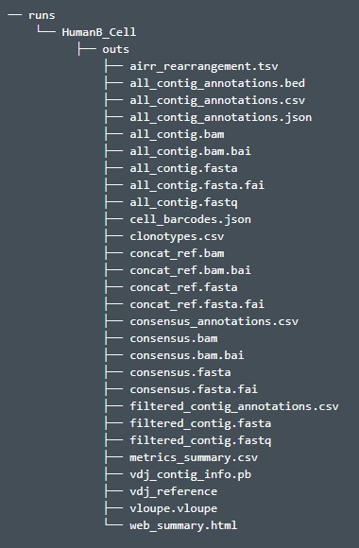
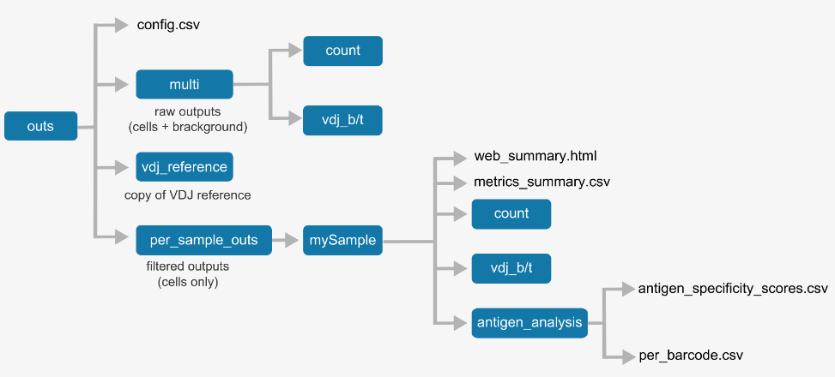
Cellranger output
cellranger vdj
cellranger multi

Slide 17
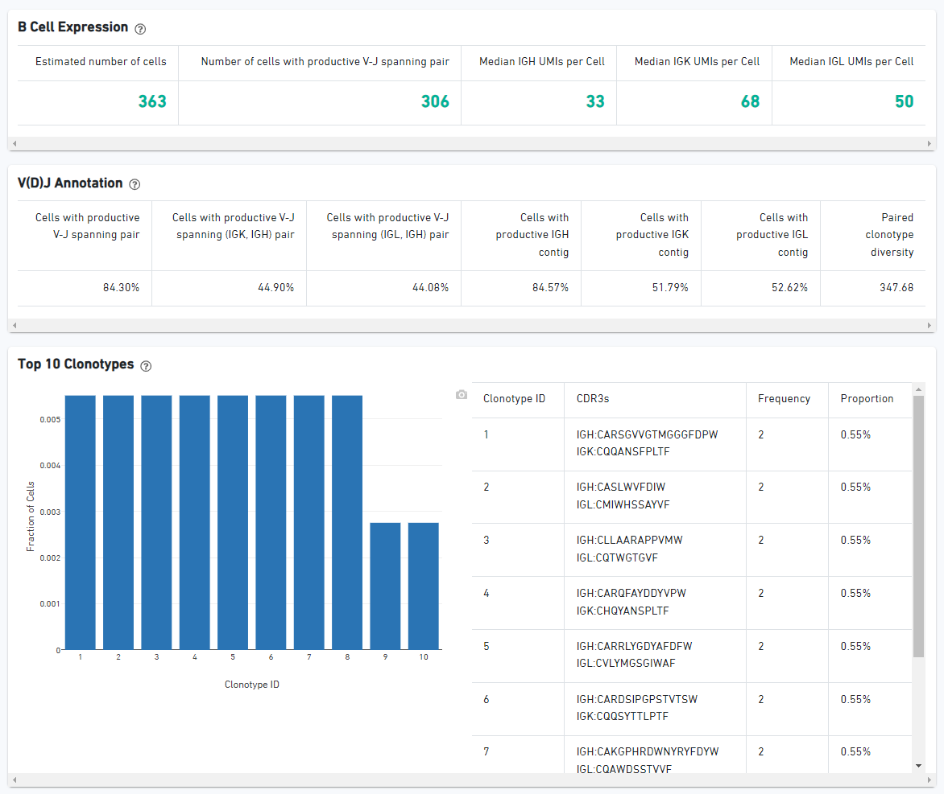
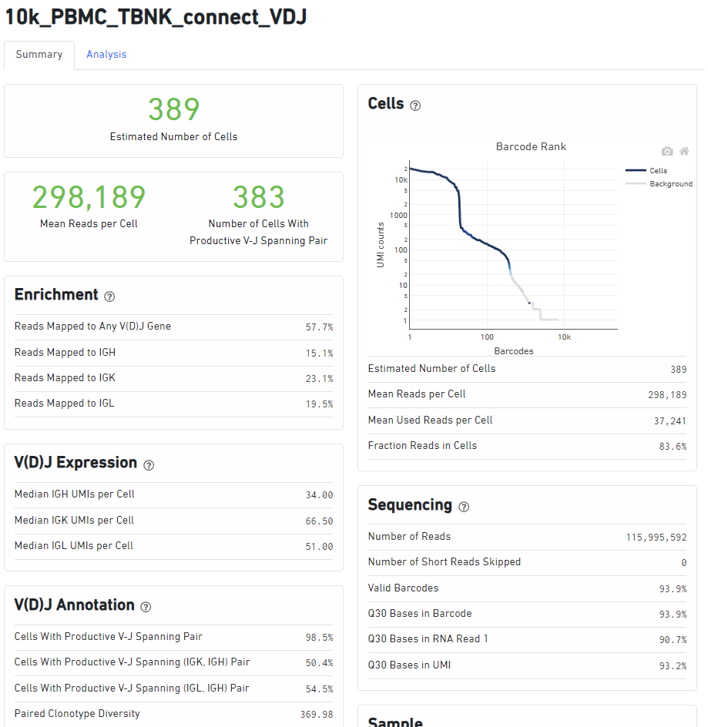
Web summary
cellranger multi
cellranger vdj

Slide 18
Tools for VDJ annotation
IMGT V-QUEST (web)
https://www.imgt.org/IMGT_vquest/input
IMGT HighV-QUEST (web)
https://www.imgt.org/HighV-QUEST/home.action
IgBLAST
https://www.ncbi.nlm.nih.gov/igblast/ (web)
https://ncbi.github.io/igblast/ (standalone)

Slide 19
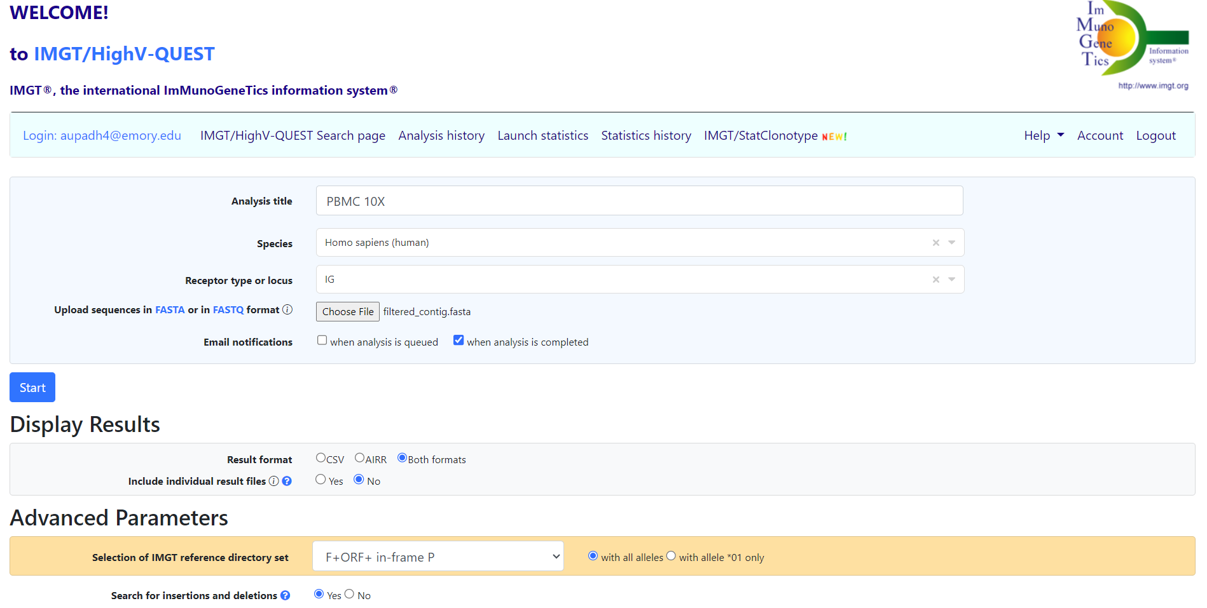
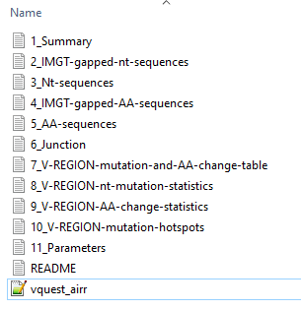
IMGT HighV-QUEST

Slide 20
IMGT HighV-QUEST- AIRR-format fields
sequence | np2 | d_score | d_germline_start | fwr3_start | c_germline_alignment_aa | d_number
sequence_aa | np2_aa | d_identity | d_germline_end | fwr3_end | junction_length | 5prime_trimmed_n_nb
rev_comp | cdr1 | d_support | d_alignment_start | fwr4_start | junction_aa_length | 3prime_trimmed_n_nb
productive | cdr1_aa | d_cigar | d_alignment_end | fwr4_end | np1_length | insertions
complete_vdj | cdr2 | j_score | j_sequence_start | v_sequence_alignment | np2_length | deletions
vj_in_frame | cdr2_aa | j_identity | j_sequence_end | v_sequence_alignment_aa | n1_length | junction_decryption
stop_codon | cdr3 | j_support | j_germline_start | d_sequence_alignment | n2_length
locus | cdr3_aa | j_cigar | j_germline_end | d_sequence_alignment_aa | p3v_length
v_call | fwr1 | c_score | j_alignment_start | j_sequence_alignment | p5d_length
d_call | fwr1_aa | c_identity | j_alignment_end | j_sequence_alignment_aa | p3d_length
j_call | fwr2 | c_support | cdr1_start | c_sequence_alignment | p5j_length
c_call | fwr2_aa | c_cigar | cdr1_end | c_sequence_alignment_aa | consensus_count
sequence_alignment | fwr3 | v_sequence_start | cdr2_start | v_germline_alignment | duplicate_count
sequence_alignment_aa | fwr3_aa | v_sequence_end | cdr2_end | v_germline_alignment_aa | cell_id
germline_alignment | fwr4 | v_germline_start | cdr3_start | d_germline_alignment | clone_id
germline_alignment_aa | fwr4_aa | v_germline_end | cdr3_end | d_germline_alignment_aa | rearrangement_id
junction | v_score | v_alignment_start | fwr1_start | j_germline_alignment | repertoire_id
junction_aa | v_identity | v_alignment_end | fwr1_end | j_germline_alignment_aa | rearrangement_set_id
np1 | v_support | d_sequence_start | fwr2_start | c_germline_alignment | sequence_analysis_category
MiAIRR: https://docs.airr-community.org/en/stable/getting_started.html

Slide 21
IgBLAST
IMGT database:
bin/igblastn -germline_db_V database/imgt.Homo_sapiens.V.f.orf
-germline_db_J database/imgt.Homo_sapiens.J.f.orf
-germline_db_D database/imgt.Homo_sapiens.D.f.orf
-c_region_db database/ncbi_human_c_genes
-organism human -query myseq
-auxiliary_data optional_file/human_gl.aux -show_translation
-outfmt 19
Can be used with custom databases
https://ncbi.github.io/igblast/

Slide 22
Immcantation pipeline
Run 10x Genomics processing script
Assigning V, D, and J genes using IgBLAST
Filtering records
Finding thresholds for cloning (automatically or manually)
Defining clonal groups
Running CreateGermlines
Calculating SHM frequency in the heavy chain V genes
$ docker pull immcantation/lab:devel
$ docker run -it --workdir /data -v $(pwd):/data:z immcantation/lab:devel bash
Template
$ changeo-10x -s filtered_contig.fasta –a filtered_contig_annotations.csv -o . –g human -t ig -x 0.1

Slide 23
Importing 10 X into Immcantation
Manual
$ AssignGenes.py igblast -s filtered_contig.fasta -b /usr/local/share/igblast
--organism human --loci ig --format blast --outdir results
$ MakeDb.py igblast -i results/filtered_contig_igblast.fmt7
-s filtered_contig.fasta --10x filtered_contig_annotations.csv
-r /usr/local/share/germlines/imgt/human/vdj/imgt_human_*.fasta --extended

Slide 24
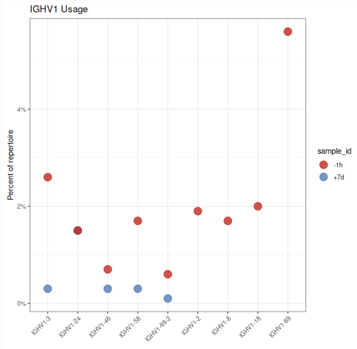
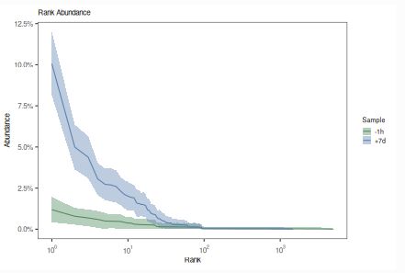
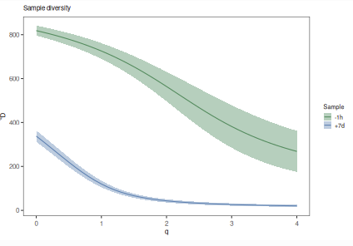
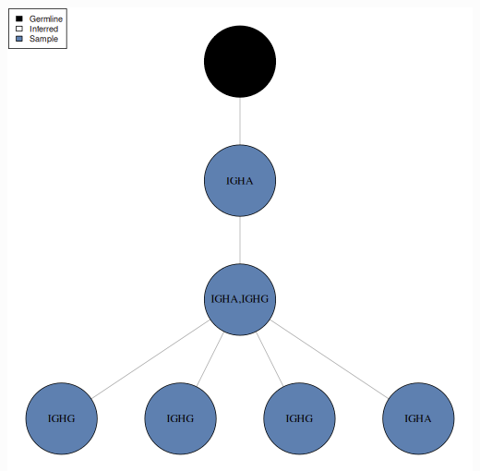
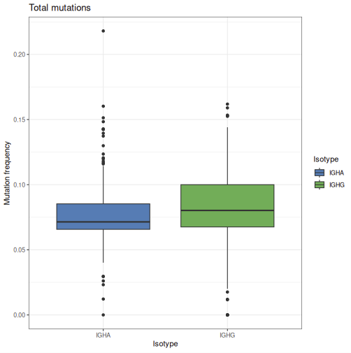
Downstream Analysis
Gene usage Analysis
Clonal abundance
Diversity curve
Lineage reconstruction
Mutation analysis
https://alakazam.readthedocs.io/
https://shazam.readthedocs.io/

Slide 25
Integrating VDJ with GEX (RStudio)
VDJ_analysis.rmd

